Slide 1



Slide 2
Profile
Rusconi & Sauza, S.C. is a law firm specialized in administrative-fiscal, civil-mercantile, corporate and immigration law, with a focus in those controversies aimed at generating positive changes in the public policy of the legislative and executive branches of government, at the local, state and federal levels. Our firm is committed to developing a modern, flexible and multidisciplinary practice, supported by technological tools, strategic alliances with experts and key individuals, and by a great sensitivity to the business and human needs of the enterprises and persons that it represents. Besides its deep understanding of the law, of the institutional practices of our country and the global context in which they take place, the main strength of Rusconi & Sauza resides in its timely and completely personalized service.

Slide 3
Clients
Rusconi & Sauza stands out for having served more than 450 Mexican clients and over 25 Chinese companies. Our clients, hailing from India, Canada, France, Germany, Switzerland, and Vietnam, bear witness to the breadth and adaptability of our offerings. We take pride in having state-owned enterprises in the mining and infrastructure construction sectors from China and France, technology companies listed on Nasdaq, and multinational corporations valued in the billions of dollars among our clients. This diversity cements us as a strategic partner for global entities looking to strengthen their presence in Mexico.

Slide 4
FINANCIAL COMPLIANCE
In Mexico, authorities such as the CNBV, the CONDUSEF or the SHCP, among others, strive to maintain an orderly financial system. Therefore, the entities that make up the Mexican financial system are highly regulated. Failure to comply with the legal provisions, or comply with them poorly, can generate exemplary sanctions and responsibilities for money laundering.
For years Rusconi & Sauza has developed a solid compliance practice aimed at companies in the financial sector such as SOFOM's or SOFIPO's and, more recently, FINTECH's, for which we have experienced collaborators as anti-money laundering compliance officers certified by the CNBV and lawyers who have been members of the list of independent arbitrators of the CONDUSEF.

Slide 5
DEFENSE AGAINST ADMINISTRATIVE AUTHORITIES
One of the primary obligations of the State is to respect the law and human rights. However, whether out of habit or due to conflicts of interest, many times the administrative authorities adopt their own agendas that violate the rights of companies and individuals that require their intervention.
For this reason, Rusconi & Sauza has developed a solid practice in defending the rights of companies and individuals against the public administration, both in those conflicts in which only the particular interests of those who have been harmed are affected. for the irregular activity of the State, as in those cases in which the protection sought implies a substantial change in the public policy prevailing up to now.

Slide 6
TAX DEFENSE
In a world of increasingly competitive markets, it is vital that companies reduce their tax burdens to the maximum extent permitted by law. However, ignoring this need, tax authorities often apply interpretive criteria that are not mandatory, or just take the most conservative interpretation of the law, increasing the cost of doing business in our country.
Therefore, Rusconi & Sauza’s team continually works to ensure that the rights of its clients are adequately protected in and outside litigation, exhausting every opportunity of defense against the tax authorities, whether local and federal, and the courts.

Slide 7
INTERNATIONAL TAX STRATEGIES
When a commercial operation has an international element (such as clients, suppliers or investors located abroad), it may not be subject to Mexican tax laws and authorities. So, the actual tax burden of such operations could be much lower than expected. Rusconi & Sauza has established alliances with tax and financial professionals from certain preferred jurisdictions in both the Pacific and the Atlantic, with the aim of providing you with the adequate information regarding the actual tax burden of your international operations, always in strict compliance to the applicable tax regulations.

Slide 8
ACCOUNTING AND TAX PLANNING
At Rusconi & Sauza we understand that a bad decision can generate expensive tax consequences. For this reason, Rusconi & Sauza’s team works continuously to lighten the burdens of our clients in front of the public administration, as well as to grant the best tax viability to their productive projects. Some of the ways in which we serve our clients regarding their tax burdens are the following:
Bookkeeping and presentation of tax returns;
General tax compliance;
Corporate structuring;
Optimization of social security and payroll structures;
Determination and optimization of the fiscal impact of investment projects.

Slide 9
LABOR LAW AND COMPLIANCE
At Rusconi & Sauza, we have experience in consulting on union matters, social security, compliance, and work on digital platforms. We focus on finding solutions with preventive measures to avoid litigation, but we also have experienced litigators who have represented clients from various industry sectors in a wide range of individual and collective lawsuits.
We negotiate and execute agreements, employment terminations, and audits. We assist employers in developing their internal regulations and in complying with official labor standards. We have extensive experience working with labor institutions and authorities in Mexico, at both federal and local levels.

Slide 10
COMMERCIAL AND CIVIL DEFENSE
In Rusconi & Sauza, we know that a vital component of the legal support that our clients need is the defense of their assets. For this reason, Rusconi & Sauza works to minimize the economic risks of our clients, as well as to solve in the most efficient terms their conflicts, whether they arise out of the illegal conduct of a counterparty, or as a result of a day-to-day business activity that requires a formal negotiation strategy or the intervention of the courts.

Slide 11
PUBLIC CONTRACTS
The public procurement market in Mexico offers important growth opportunities for any company. Therefore, when participating, it is vital that the company has specialized advice that maximizes the chances of not being disqualified due to the lack of compliance with the formalities required by law.
Also, sometimes, even complying with the applicable rules, the contracting areas come to violate the fairness that must prevail, imposing disproportionate or unconstitutional requirements or bypassing the rules applicable to the procedures.
Therefore, whether through preventive advice or through litigation, Rusconi & Sauza is prepared to defend the rights of participants in public procurement in Mexico.

Slide 12
SANITARY LAW
The activities related to public health occupy a prominent position within the functions of the State. Therefore, in the Mexican legal system there are many provisions that regulate the role of health authorities and compliance with existing regulations.
Therefore, Rusconi & Sauza provides legal and practical solutions for those who participate in the different activities of the public and private health sector, both in public procurement procedures, in obtaining health records or licenses, or in those related to administrative responsibilities.

Slide 13
INSURANCE AND GUARANTEES
Guarantees and insurance are instruments of great importance that have been intended to provide support against the risks of non-compliance, or those derived from acts of God and force majeure. Its processing and execution require specialized personnel to be effective.
At Rusconi & Sauza we advise our clients on how to insure their assets or services, or on how to make their guarantees effective.
Also, at Rusconi & Sauza we can advise you so that you can choose the best option in insurance and guarantees according to your needs, and so that in the event of a risk or loss you can execute it correctly.

Slide 14
MIGRATORY LAW
We have more than thirteen years of experience and solid relationships with immigration authorities in procedures such as authorization of work visas, change of status of stay for temporary or permanent residents, renewal of temporary residence, obtaining proof of employment before INAMI, fulfillment of obligations of foreigners such as notification of change of workplace, change of address, change of nationality or name, Mexican naturalization and Mexican passport, deportation and assisted return procedures. Rusconi & Sauza’s clients are Mexican and multinational companies, as well as foreign individuals looking to invest in Mexico.
Our excellent results and recommendations are the source of our growth.

Slide 15
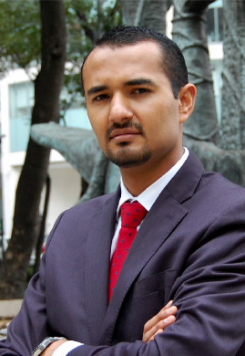
EDUARDO RUSCONI
Eduardo is a lawyer educated in Mexico, Japan and Australia, experienced in administrative-tax and civil-commercial litigation, negotiation and mediation. Eduardo Rusconi is a graduate of the Faculty of Law at the National Autonomous University of Mexico, with the thesis Second Degree Money Laundering, Analysis of its Various Forms of Commission and its Tax Effects. In 2011 he completed a master’s degree in International Economic and Business Law at the University of Kyushu, in Japan, graduating with the thesis The Role of Financial Derivatives in the Financial Crisis of 2007, and in 2016 he concluded a master’s degree in International Tax Law at the University of Melbourne, Australia. Additionally, in 2017, Eduardo obtained a diploma in Strategic Litigation in Human Rights, by UNAM’s Institute of Legal Research. Also, Eduardo is the Mediator number 213, certified by the Mexico City’s Judiciary.
Prior to founding Rusconi & Sauza, he worked for Solórzano, Carvajal, González & Pérez Correa, S.C. and Barrera, Siqueiros & Torres Landa, S.C. (now Hogan Lovells BSTL). Eduardo has taught the subjects ‘Formation of Regional Economic Blocks’ at Universidad Anahuac, and ‘Human Rights’ at Universidad La Salle.

Slide 16

SELENE SAUZA
Selene is a lawyer specializing in immigration matters, who graduated from the Faculty of Law at the National Autonomous University of Mexico, with honors. She also has a specialty in constitutional law and a Master in Tax Law. Her career began in 2002 as an intern in different law firms specialized in family matters until becoming senior associate.

Slide 17
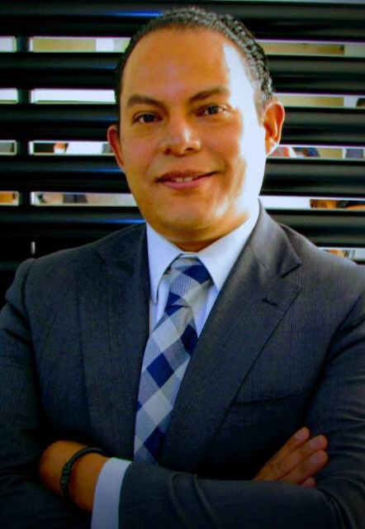
JOSÉ LUIS ALONSO
José Luis has a law degree from the National Autonomous University of Mexico (UNAM), a public accounting degree from the Monterrey Institute of Technology and Higher Education (ITESM), as well as a diploma in International Taxation from the Autonomous Technological Institute of Mexico (ITAM) and Duke University, and a diploma in International Commerce from Escuela Libre de Derecho and the International Chamber of Commerce (ICC). He has also completed the program of the master’s degree in American Law at the Institute of Legal Research at UNAM. José Luis specializes in tax strategy, international taxation, corporate reorganizations and litigation in tax and administrative matters.
Prior to joining Rusconi & Sauza, José Luis was Tax Manager of P.M.I. Comercio Internacional, S.A. de C.V. (PMI), a subsidiary of Petróleos Mexicanos (PEMEX) that commercializes hydrocarbons in the international market, where he was responsible for the taxation of Mexican, American, Spanish and Dutch corporations, as well as a Singaporean branch. In addition, José Luis’s career comprehends prestigious organizations such as PricewaterhouseCoopers, S.C. (PwC), Ruiz Urquiza y Cía, S.C. (Arthur Andersen) and the Mexican Central Bank.

Slide 18
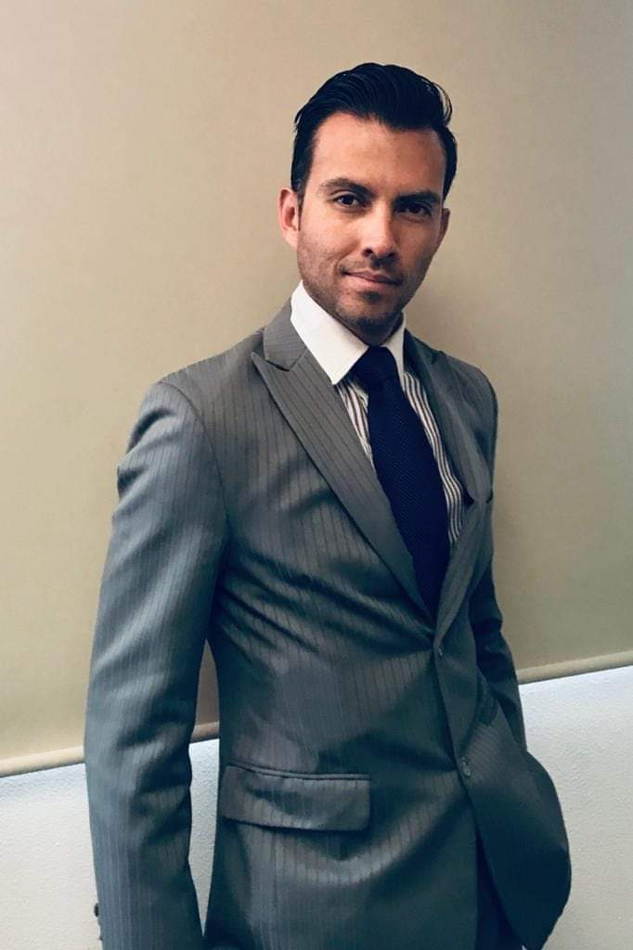
RENÉ VIRUEGA
René Viruega has a Law Degree with a Specialty in Business Law, Master's Degree and a PhD from UNAM, Magna Cum Laude. He is an experienced lawyer in business, commercial, insurance and surety law who has provided his services in the private sector in law firms and in Afianzadora Insurgentes, as well as in the public sector in the Ministry of Finance and Public Credit (SHCP).
He has been a speaker at congresses in Mexico, Colombia and Spain, in addition to being a two-time winner in the research competitions of the National Insurance and Surety Commission with the works: ‘Violation of the constitutional principles of equality and legal security in procedures for requesting and claiming payment of the amounts guaranteed in the surety policies’ and ‘Electronic insurance and surety. Project: General provisions.’

Slide 19

LOURDES LANDA
Lourdes Landa is a Certified Public Accountant, graduated from Universidad Mexicana, with various courses in accounting and government auditing from the Mexican Institute of Public Accountants, with 22 years of experience in finance, accounting and taxes, as well as in the implementation and adaptation of administrative-accounting software in companies.
Prior to joining Rusconi & Sauza, Lourdes has worked as Head of Financial Information in Border Ports at the Institute of Administration and Appraisals of National Assets, General Treasurer in the South Delegation of ISSSTE, Leader of Financial Analysis at IUSACELL, Head of Inspection and Accounts Payable in the Public Broadcasting System of the Mexican State (SPR) and General Accountant in Facultad de Cine, SC, among other positions in accounting and finance.

Slide 20

ADRIANA MORALES
Adriana Morales is a lawyer graduated from the Law School of the National Autonomous University of Mexico, with experience in the public and private sectors, as well as in teaching.
Prior to joining Rusconi & Sauza, Adriana served as Deputy Director of Public Services in the Civil Registry of Mexico City, Public Defender of Mexico City, advisor in the Directorate of Legislative Studies of the Legal Department and advisor to the General Legal Counselor, both of the Government of Mexico City.
In the academic field, Adriana completed a diploma in selected topics of corporate law taught by the Division of Postgraduate Studies of UNAM, and has also been an adjunct professor of the subjects 'Constitutional Law' and 'Individual Guarantees' at the same university.

